Slide 1
Modelling of atmospheric volatile organic compounds using the EMEP MSC-W
model
Yao Ge¹, David Simpson¹, Sverre Solberg², Willem E. van Caspel¹, Hilde Fagerli¹, Svetlana Tsyro¹, Mathew Heal³
Norwegian Meteorological Institute
Norwegian Institute for Air Research
University of Edinburgh
Notes:
Some latest results from our ongoing work on modelling of xxx

Slide 2
Atmospheric VOC-NO_{x}-O₃ chemistry
VOCs come from both biogenic and anthropogenic sources
VOCs and NO_{x} are two major precursors for O₃ in the troposphere
Changing VOCs and NO_{x} levels affect the amount of O₃ formed
VOC-NO_{x} chemistry
/NO₃/…
Solvent
Vegetation; Biomass burning; Solvent usage; Fuel production and combustion; Motor vehicles
Respiratory disease; Plant impairment
Notes:
To start with, a brief introduction of the VOC chemistry. VOCs come from both biogenic sources like vegetation and anthropogenic sources like solvent xxx. Once emitted into the atmosphere, they react with xxx to form peroxy radicals when then participate in the formation of Ozone. So changing VOC and NOx levels xxx. These air pollutants have adverse effects on both human health and plant.

Slide 3
Research questions
How comparable is the model/inventory VOC speciation to measured values?
Are the modelled relative ratios of anthropogenic and biogenic VOC "about right"?
Future work:
How important are the different classes of VOC to ozone formation?
Can we improve the speciation used in the EMEP model using hints from measurements?
The first intensive comparisons of VOCs between EMEP model and measurements for many years
Notes:
The research questions we try to investigate now are xxx. After we have had enough confidence in model results, the questions we will be looking at in the future are xxx
These are the motivations of the study presented here which is the first intensive compassions of VOCs xxx

Slide 4
VOCs in EMEP model: expanded species set
Alkane: | C₂H₆ | C₃H₈_T | NC₄H₁₀_T | IC₄H₁₀_T
Alkene: | C₂H₄ | C₃H₆ | C₄H₈_T
Alkyne: | C₂H₂_T
Aromatic hydrocarbon: | C₆H₆ | C₆H₅CH₃ | C₆H₄(CH₃)₂
Alcohol: | CH₃OH | C₂H₅OH | 1-Propanol_T | 2-Propanol_T
Aldehyde: | HCHO | CH₃CHO | C₂H₅CHO_T
Ketone: | CH₃COCH₃_T | MEK
Carboxylic acid: | HCOOH_T | CH₃COOH_T
Biogenic VOC: | C₅H₈ | α-Pinene | β-Pinene
Oth_alkane_T | the rest VOCs
EmCHEM19-voc and CRIv2R5: 14 previous VOCs + 11 new VOCs (_T), 25 in total
A tracer system: explicit emissions + OH/NO₃/… removal pathways, for tracking VOC concentrations
Tracers’ participation in O₃ formation : a lumped surrogate, e.g., following NC₄H₁₀ chemistry
Notes:
We currently have two chemistry mechanisms ready. Compared to previous version, I have added 11 new VOC tracers, coloured in blue with the suffix underscore T.
This is achieved by a tracer system. We feed these VOC tracers explicit emissions and let them be consumed by radicals like OH and NO3, so that we get explicit concentrations of these tracers.
In terms of tracers’ participation xxx, they are treated as a lumped xxx

Slide 5
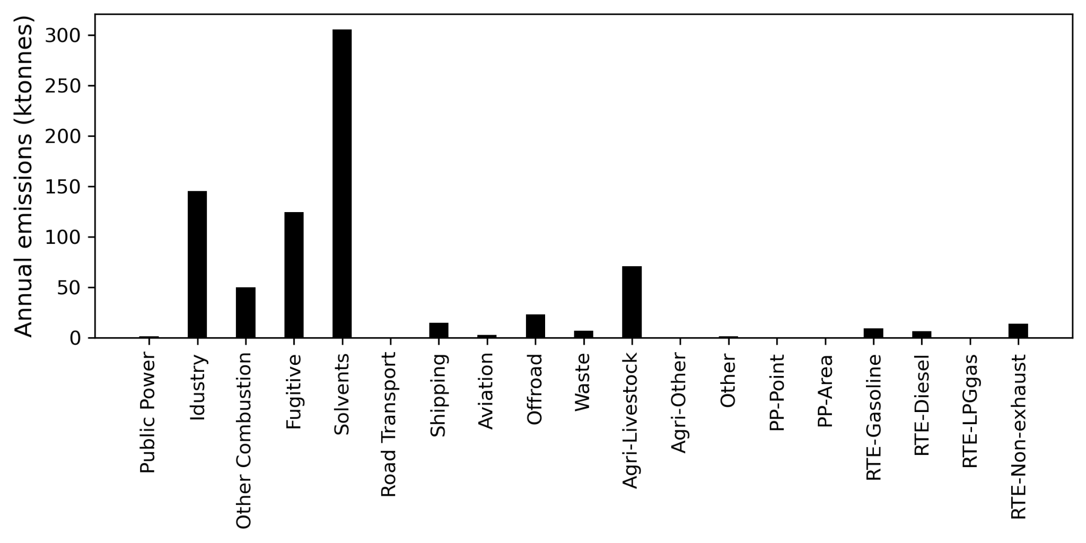
Model simulation: configuration
2022 runs: 2019 emissions, 2022 meteorology, 0.1 ° resolution
Measurements: 2022 intensive measurement periods (IMPs), 12-20th July
Large emitting sector: Industry, Other combustion, Fugitive, Solvents
Road Transport Exhaust
Industry
RT
Notes:
The EMEP model runs for 2022 used xxx
This is an example of annual total emissions from 19 sectors, the large emitting sectors are xxx
Gridding Nomenclature for Reporting (GNFR) emission categories (A to L), i.e., industry, ...

Slide 6
Model simulation: configuration
VOC Speciation: based on the latest speciated UK national atmospheric emissions inventory (NAEI)
Large emitting sector: Industry, Other combustion, Fugitive, Solvents
Large emitting VOCs: Benzene, NC₄H₁₀, C₂H₅OH, C₂H₄, C₂H₆
C₂H₆
C₂H₅OH
NC₄H₁₀
NC₄H₁₀
C₂H₄
Benzene
C₂H₆
Benzene
Notes:
Different colours represent different species. Apparently, most VOCs have multiple sources: so in general, not so many vocs are precise indicators for particular sources. The speciation of agri-VOC wasn't available when I started, but we are working on this.
Among these large emitting sectors, the large emitting VOCs include xxx, So the model-measurement comparisons focus on these species.

Slide 7
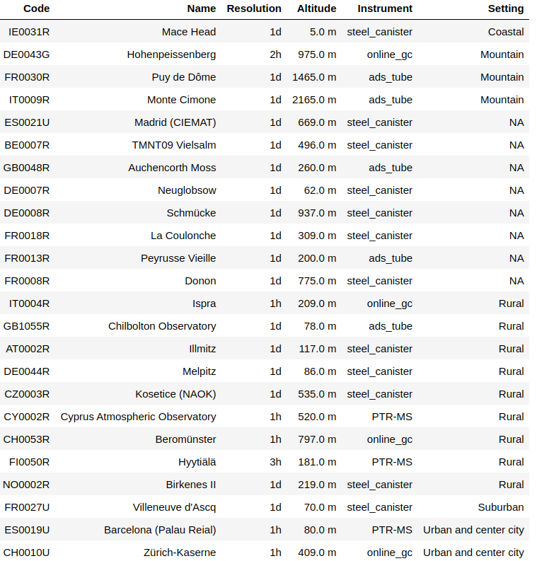
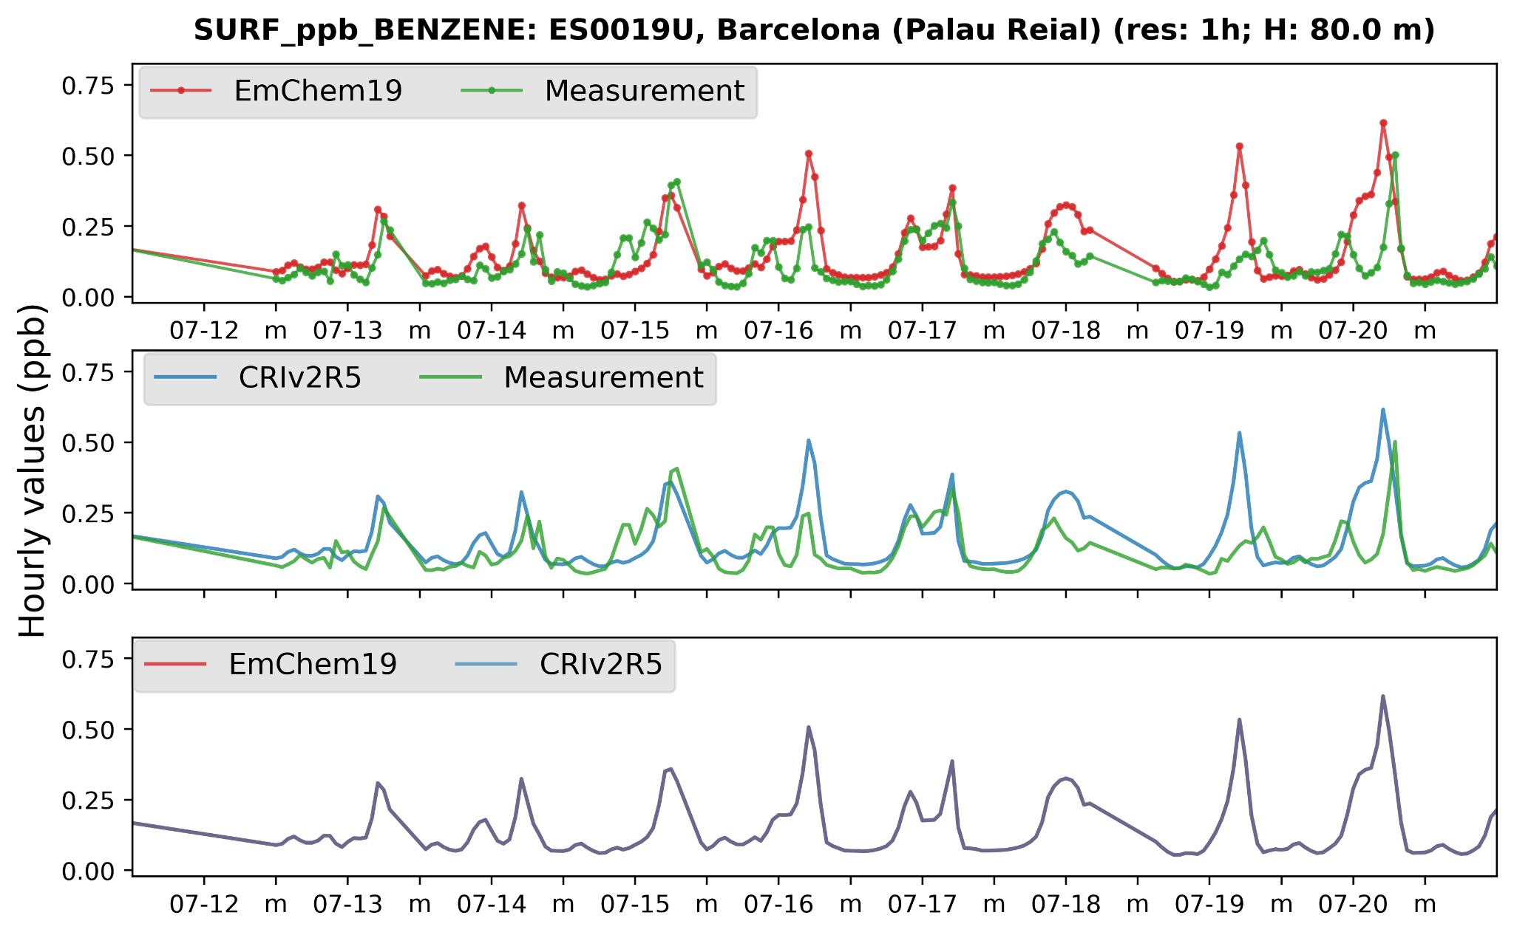
Model-Measurement comparison: Benzene
24 sites
Emission: combustion, transport, etc.; OH removal
The model captures the temporal variations well at two urban stations
No large difference between the 2 mechanisms
Notes:
For Benzene, its emissions include xxx, its removal pathway is mainly reaction with OH.
During this campaign, there are 24 sites measuring benzene at hourly and daily resolution, and covering different station settings.
We first looked at urban stations as benzene is mainly from anthropogenic sources. In this time series plot, green represents the measurements, the red line xxx
In another urban station, the model performance is similar.
We also looked other hourly comparisons at these rural stations.

Slide 8
Model-Measurement comparison: Benzene
Hourly comparisons: mixed results; different concentration spikes
Daily comparison: one-hour measurement at 12 pm per day
Altitude issue: high-altitude measurements cannot be compared with modelled surface concentrations
Rural
Rural
Rural
Suburban
Rural
Rural
Notes:
At these two rural stations, one in finland, one in Italy, the model shows mixed results
For daily measurements, they are measured one hour at 12 pm every day, it is still an hourly measurement, so we use the modelled hourly value also at 12 pm to compare. The m label here represents the midday 12 pm. However, within 8 data points, it is difficult to conclude anything.
We also looked at one high-altitude station at almost 800 meters, the issue is that these measured values cannot be xxx, so it is also difficult to get any conclusions from such comparison.

Slide 9
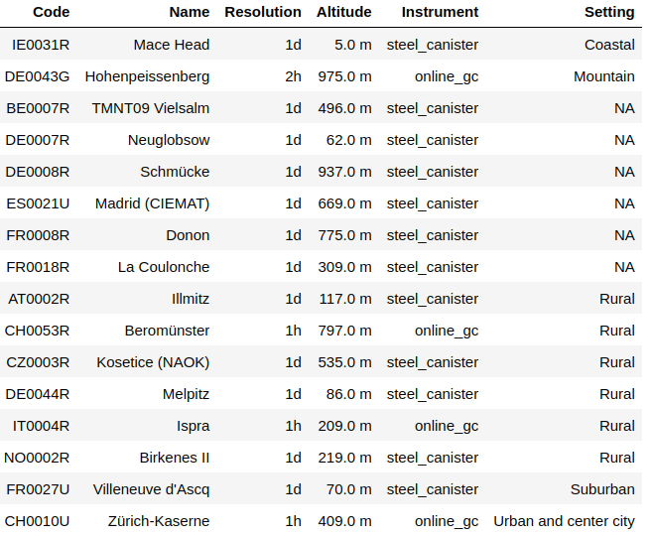
Model-Measurement comparison: N-Butane
Emission: fugitive, solvent, transport; OH removal
Mixed results: good agreement at hourly and daily comparisons; varying concentration spikes
NA
16 sites
Rural
Rural
Urban
Notes:
Next, we looked at n-butane, another large emitting hydrocarbon species. It is mainly from xxx, and consumed by OH.
In total, there are 16 sites for N-butane. Here we shows 2 examples of hourly measurements, and 2 examples of daily measurements at low altitude.
Both daily and hourly comparisons show good agreements with varying xxx such as here. In general, the results do not show large differences between rural and urban sites, they are equally good for nbutane.

Slide 10
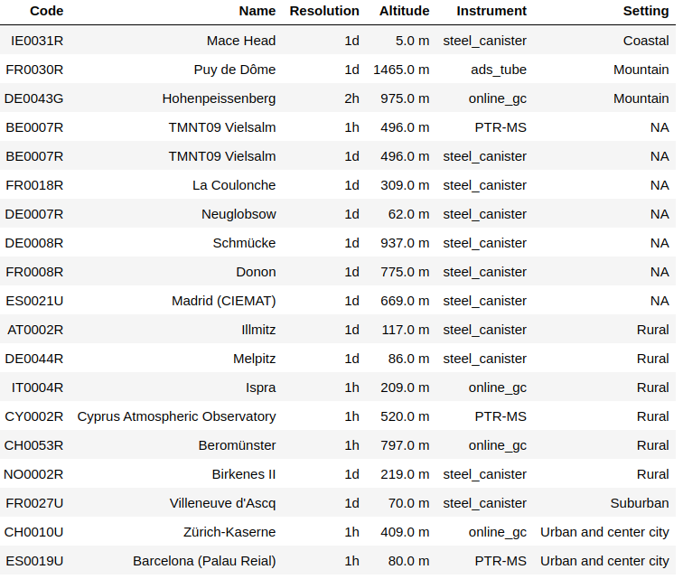
Model-Measurement comparison: Isoprene
Emission: biogenic sources; OH/NO₃/O₃ removal
Mixed results: good agreements on temporal variations at some stations; model underestimation at one urban station
NA
19 sites
Rural
Suburban
Urban
Notes:
Next, the biogenic VOC, isoprene.
There is probably more vegetation in the city than the inventories think, we want to know from measurement and emission community about the latest understanding of urban biogenic emissions.

Slide 11
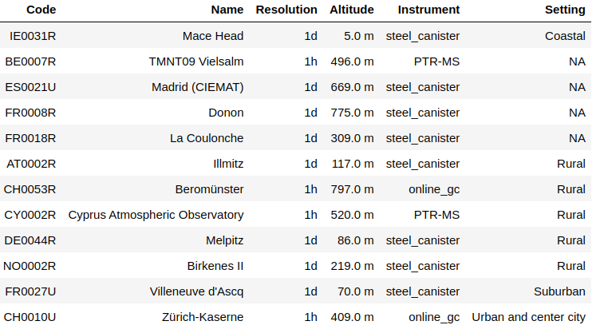
Model-Measurement comparison: Ethanol
Emission: Industry, combustion, solvents; OH removal
Worse performance than benzene and n-butane
Model overestimation at the urban station, underestimation at other three stations
Speciation/chemistry?
NA
NA
12 sites
Rural
Urban
Notes:
In the first three panels, the modelled values are too low and do not show any diurnal variations like what the measurement shows. This may be due to for instance the emissions are too low or the chemical losses are too strong. In this urban station, for example, the model may contain relatively larger grided emissions or this site is far away from the real-world sources like solvents usage. It is difficult to infer at current stage, we need longer period comparisons.

Slide 12
Comparison of O₃-NO_{x}-VOC
Zürich-Kaserne, Switzerland, Urban station
O₃ and NO_{x} : a good agreement on their diurnal variations; varying peak concentrations
VOCs: better performance for benzene, n-butane, ethane and ethene than ethanol
Longer period comparison needed

Slide 13
Summary
First intensive comparisons of VOCs for many years
Comparisons are limited by the lack of hourly measurements at low altitude
Based on current results, hydrocarbon VOCs are modelled better than OVOCs
Mixed results are found for most VOCs, e.g. varying performance across stations
Longer period (e.g., a full year) comparisons are required to draw more general conclusions
Ideally, simultaneous measurements of VOCs, O₃ and NO_{x} at the same location are required
Discussion with measurement and emission experts needed
This work will continue
Notes:
This VOC comparison study will continue

Slide 14
Acknowledgement
We gratefully acknowledge the time and effort invested in this comprehensive measurement campaign, as well as all other VOC measurements conducted over the years
We express our gratitude to the UK NAEI community for providing us with the VOC speciation data

